Slide 1
ARRAYS IN JAVA

Slide 2
Declaring Array Variables
Syntax
dataType[] a; // preferred way.
or
dataType a[]; // works but not preferred way.
Example
double[] myList;
or
double myList[];

Slide 3
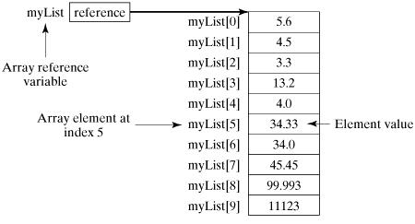
Creating Array
double[] myList = new double[10];
OR
double[] myList;
myList = new double[10];

Slide 4
Processing Arrays
class TestArray {
public static void main(String[] args) {
double[] myList = {1.9, 2.9, 3.4, 3.5};
// Print all the array elements
for (int i = 0; i < myList.length; i++) {
System.out.println(myList[i] + " ");
}
// Summing all elements
double total = 0;
for (int i = 0; i < myList.length; i++) {
total += myList[i];
}
System.out.println("Total is " + total);
}
}
Output
1.9
2.9
3.4
3.5
Total is 11.7

Slide 5
The foreach Loops
JDK 1.5 introduced a new for loop known as foreach loop or enhanced for loop, which enables you to traverse the complete array sequentially without using an index variable.
class TestArray {
public static void main(String[] args) {
double[] myList = {1.9, 2.9, 3.4, 3.5};
// Print all the array elements
for (double element: myList) {
System.out.println(element);
}
}
}
Output
1.9
2.9
3.4
3.5

Slide 6
Passing Arrays to Methods
public static void printArray(int[] array)
{
for (int i = 0; i < array.length; i++)
{
System.out.print(array[i] + " ");
}
}
printArray(new int[]{3, 1, 2, 6, 4, 2});
Or
int[] array={3, 1, 2, 6, 4, 2};
printArray(array);

Slide 7
Returning an Array from a Method
public static int[] reverse(int[] list)
{
int[] result = new int[list.length];
for (int i = 0, j = result.length - 1; i < list.length; i++, j--)
{
result[j] = list[i];
}
return result;
}

Slide 8
Multidimensional array in java
dataType[][] arr;
dataType arr[][];
dataType []arrr[];
Example to instantiate Multidimensional Array in java
int[][] arr=new int[3][3];//3 row and 3 column

Slide 11
Class PrintMatrix
{
int a[][], rows, cols;
void acceptmatrix(int r,int c)
{
----
}
void printmatrix()
{
}
Main()
{
p1
P1.acceptmatrix(3,3);
P1.printmatrix();
}
}

